Slide 1
Welcome to Advanced Calculus!
Also know as
Multivariable Calculus (MVC) ← Malan’s favorite name ☺
Calc III
Requirements:
ISQ credit + 4 or 5
Self study + 5

Slide 2
What is Multivariable Calculus?
What have you heard? Discuss with partner.
30 seconds later…
Mr. Malan: “Student A, what did your partner say?”

Slide 3
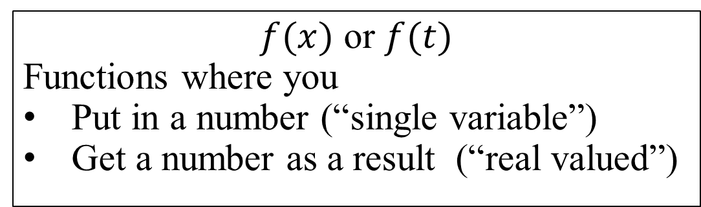
What is Multivariable Calculus?
Start with (Malan’s) definition of Single-variable Calculus:
Differentiation and integration of real-valued functions of a single variable.
$f(x)$ or $f(t)$
Functions where you
Put in a number (“single variable”)
Get a number as a result (“real valued”)
Notes:
All our friends are here.
Velocity functions where we want to find distance traveled
Profit function that we want to maximize
Curve where we’re looking for local min
$F\left(x\right)=\cos^{5}{(x)}$ and we want $f$ where $f^{′}\left(x\right)=F(x)$

Slide 4
What is Multivariable Calculus?
Start with (Malan’s) definition of Single-variable Calculus:
Differentiation and integration of real-valued functions of a single variable.
Malan’s definition of MVC:
Mess up this part as many ways as possible.
But still focus on differentiation and integration of functions.

Slide 5
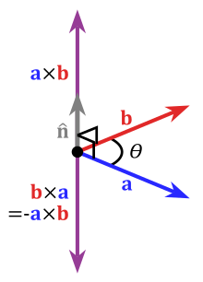
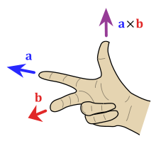
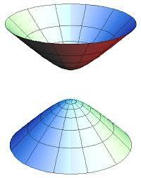
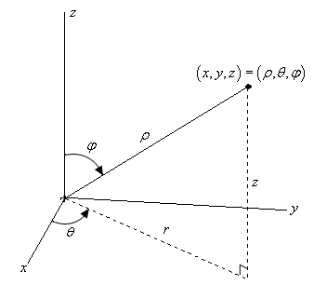
What is Multivariable Calculus?
Chapter 11: Boot Camp
No calculus 😒. (No derivatives/integrals.)
Instead, LOTS of practice with vectors and 3d graphing concepts
Fast
Notes:
Why vectors? They will give us the language with which we can elegantly ask and answer 3D questions.

Slide 6
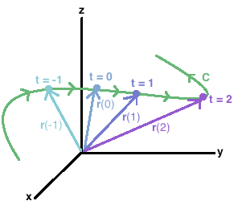
What is Multivariable Calculus?
Chapter 12: Vector Valued Functions
Differentiation and integration of vector-valued functions of a single variable.
VVFs:
Good for modeling motion of a particle through space
Feels like parametric, but vector language lets us do much more
Position, velocity, accelerator, curvature, arc length

Slide 7
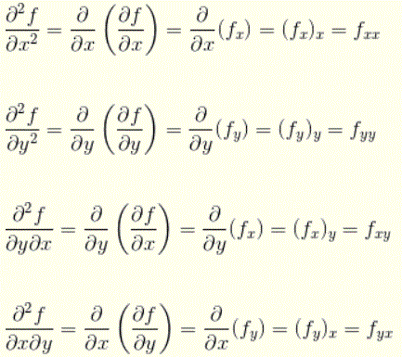
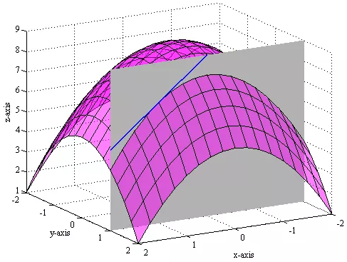
What is Multivariable Calculus?
Chapter 13: Partial Derivatives
Differentiation and integration of real-valued functions of multiple variable.

Slide 8
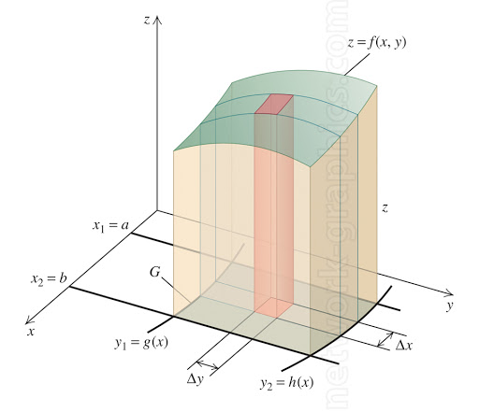
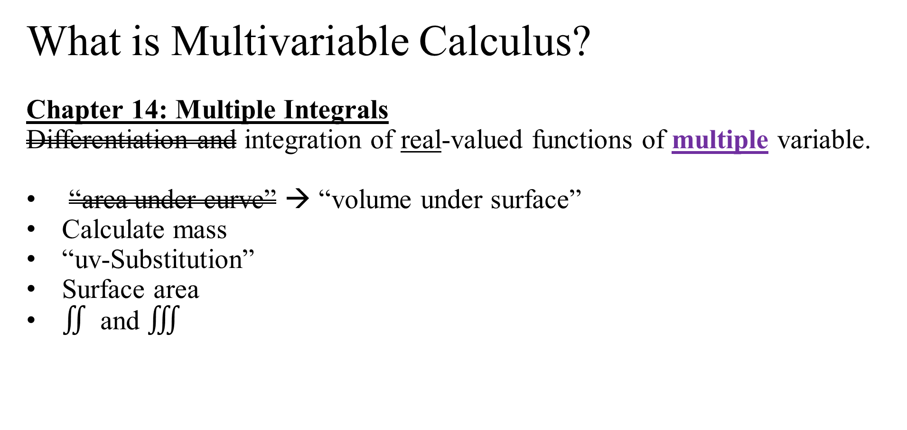
What is Multivariable Calculus?
Chapter 14: Multiple Integrals
Differentiation and integration of real-valued functions of multiple variable.
“area under curve” → “volume under surface”
Calculate mass
“uv-Substitution”
Surface area
$∬$ and $∭$

Slide 9
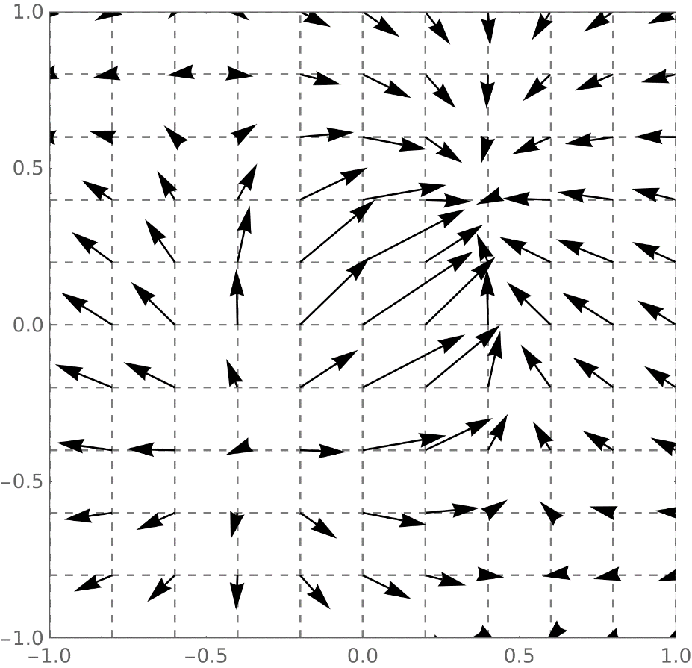
What is Multivariable Calculus?
Chapter 15: Vector Analysis
Differentiation and integration of vector-valued functions of multiple variable.

Slide 10
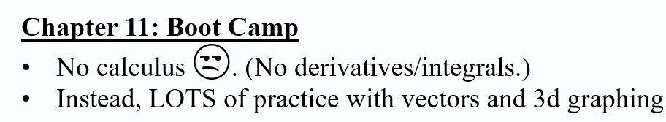
So where do we start?
A Promise: Every concept from Ch 11 will be used later on.

